Slide 1
Bengali Sign Language
Anamika Dey
BT18CS016
NATIONAL INSTITUTE OF TECHNOLOGY, Mizoram
Guided by:
DR Ranjita das

Slide 2
Context
Sign Language Recognition
Different Method for Sign Language Recognition
MediaPipe
MediaPipe Hand
Database Description
Model
Conclution
Reference

Slide 3
Sign Language Recognition
Sign language is an important part of communication for people with speaking and hearing disability.
In the modern world, almost every spoken language has its own verified sign language which is parallel to the written language. It is an important part of linguistics for translating the sign language to the written form to communicate effectively with other audiences who do not know the signs .
Sign Language Recognition systems are used to detect signs of numbers, alphabets, words or any other signs.

Slide 4
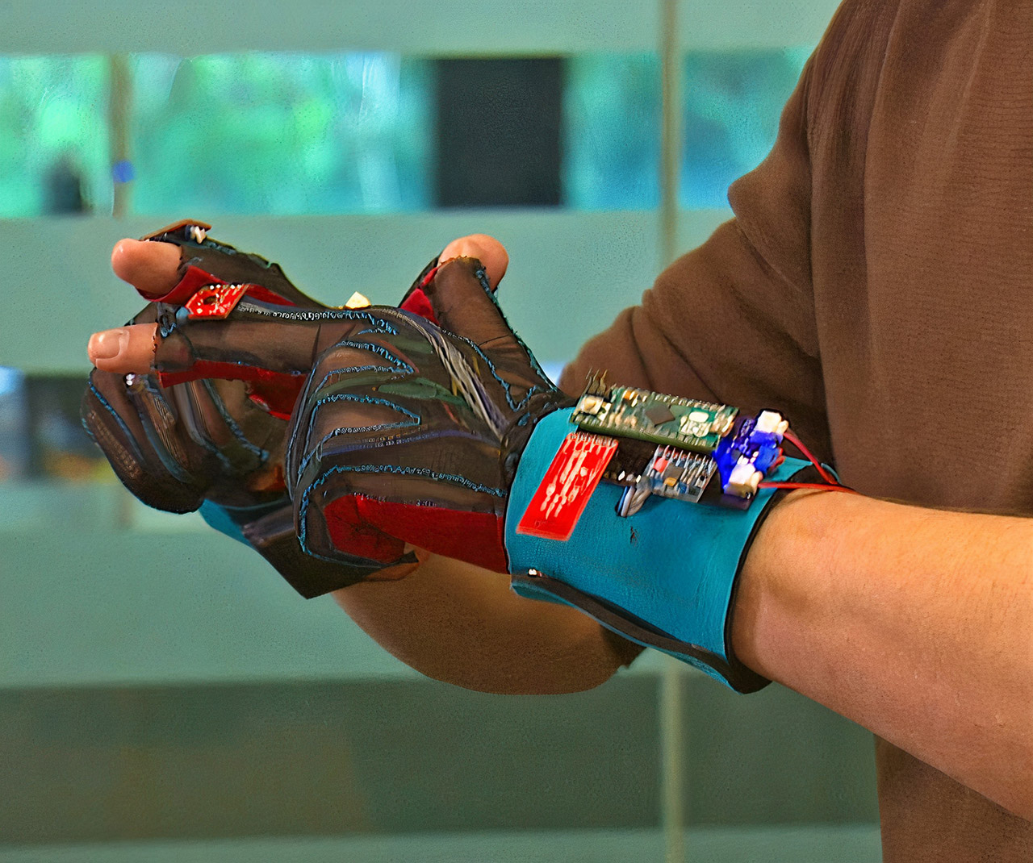
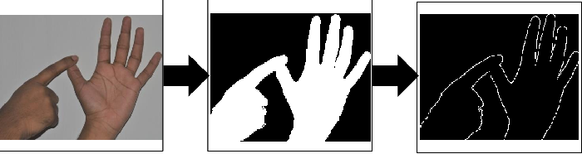
SignAloud Smart Gloves Turns Sign Language Into Speech
DIFFERENT METHOD OF SIGN LANGUAGE ESTIMATION
Hand gesture recognition has been an active research field for the past 20 years, where various different approaches have been proposed.
Sign Language Recognition with Skin Segmentation and Binary Masking

Slide 5
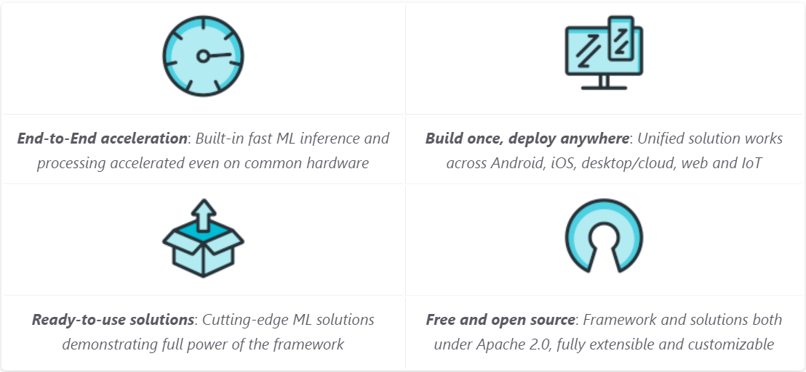
MediaPipe
MediaPipe is a cross-platform framework for building multimodal applied machine learning pipelines
MediaPipe is a framework for building multimodal (eg. video, audio, any time series data), cross platform (i.e Android, iOS, web, edge devices) applied ML pipelines. With MediaPipe, a perception pipeline can be built as a graph of modular components, including, for instance, inference models (e.g., TensorFlow, TFLite) and media processing functions.

Slide 6


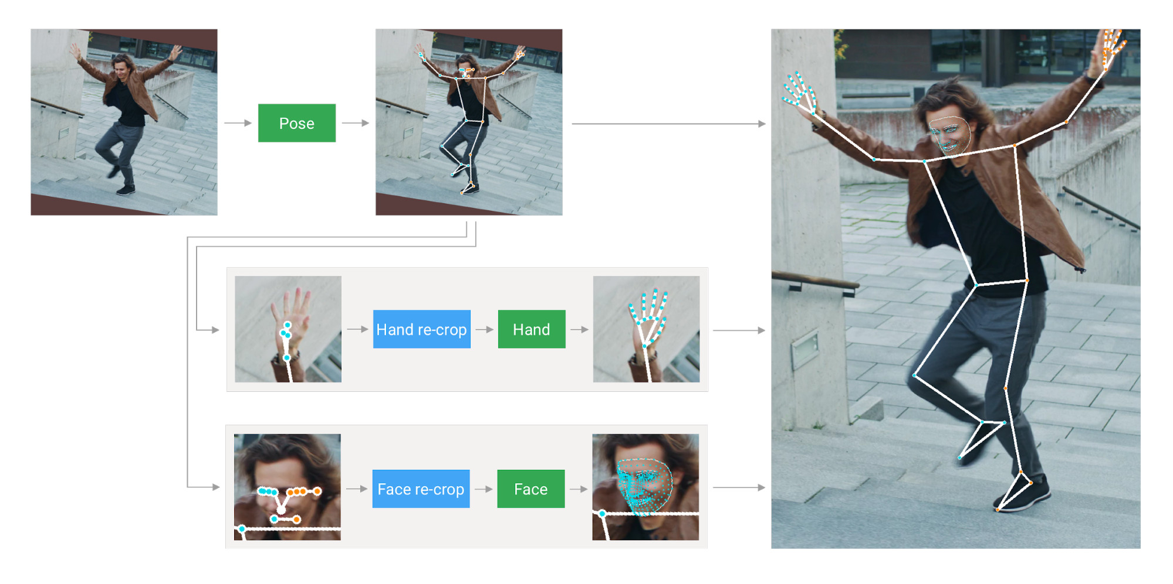
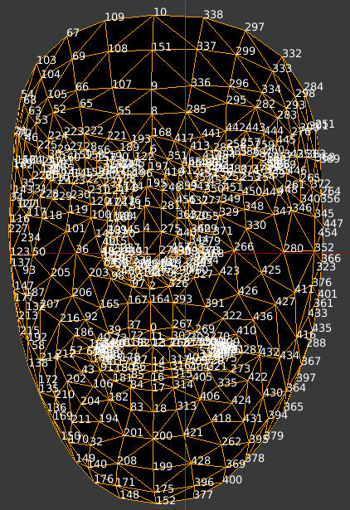
MediaPipe Hand Landmarks
MediaPipe pose Landmarks
MediaPipe Face
MediaPipe Holistic

Slide 7
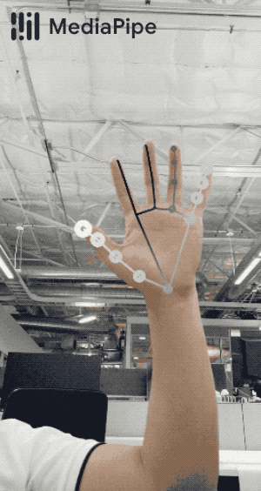
MediaPipe Hand
MediaPipe Hands is a high-fidelity hand and finger tracking solution. It employs machine learning (ML) to infer 21 3D landmarks of a hand from just a single frame
MediaPipe Hands utilizes an ML pipeline consisting of multiple models working together:
A palm detection model that operates on the full image and returns an oriented hand bounding box
A hand landmark model that operates on the cropped image region defined by the palm detector and returns high-fidelity 3D hand keypoints.

Slide 8
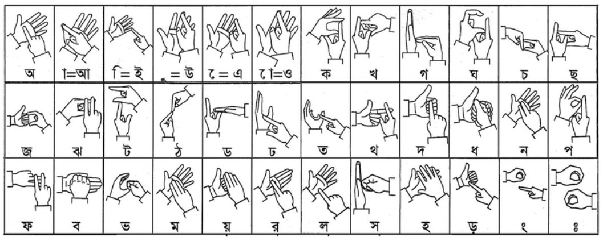
Bengali Sign Language Recognition
Bengali Sign Language (BSL) recognition research came into focus in the last decade; different methods have been proposed to implement Bengali Sign Language Recognition system.
The Bengali Language has 51 letters ,which can be represented by 36 signs by grouping similar sounding alphabets into one single sign. The hand Sign of all the grouping are shown in Fig
We will be using Mediapipe to extract all the key-points of the different hand gestures and store them in a dataset.
The Model Created using this Dataset helps in recognizing the Sign Language in real time.

Slide 9
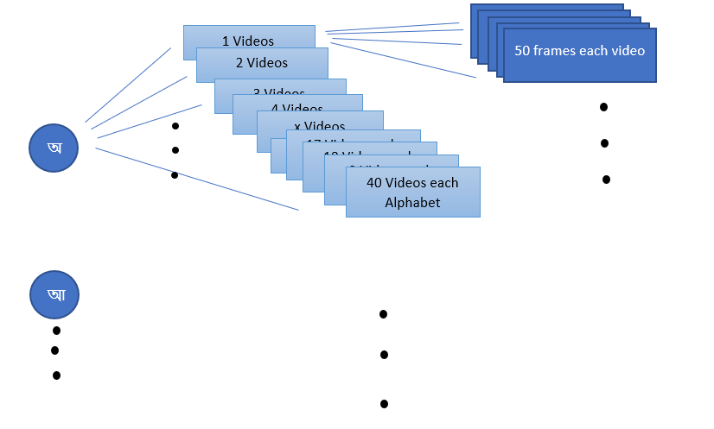
DATABASE DESCRIPTION
The Database is the collection of all the hand Landmarks of the sign language of all the 36 Bengali letters
Each Letters has 40 video clips each and each Video clips is a total of 50 frames
There are a total of 42 landmarks for both hands (each hands containing 21 landmarks)
Each landmarks have X,Y and Z yalues , which determines the position of the particular landmark

Slide 10
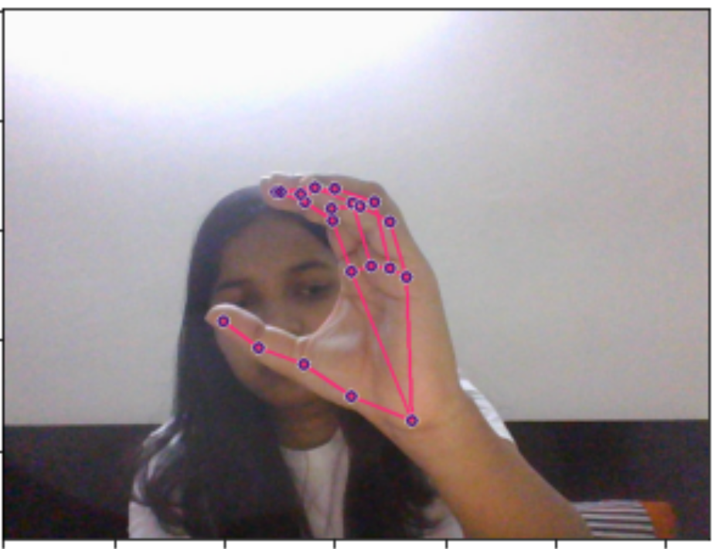
Fig : Key points of hand landmark corresponding in coordinate (x,y,z) in MediaPipe for one hand gesture
[
x: 0.5799211 y: 0.77871823 z: -9.488375e-08 ,
x: 0.4941706 y: 0.7323965 z: -0.014575872 ,
x: 0.42686632 y: 0.67285687 z: -0.030620316 ,
x: 0.36257324 y: 0.64056814 z: -0.05372462 ,
x: 0.3134956 y: 0.59046435 z: -0.074887834 ,
x: 0.4941839 y: 0.4959416 z: 0.025397537 ,
x: 0.468078 y: 0.40030083 z: 0.00018479527 ,
x: 0.42863292 y: 0.36549807 z: -0.029410591 ,
x: 0.38879937 y: 0.34741893 z: -0.05027845 ,
x: 0.5220176 y: 0.48672414 z: 0.008993606 ,
x: 0.495883 y: 0.36699313 z: -0.018622683 ,
x: 0.4435193 y: 0.33822367 z: -0.045873467 ,
x: 0.3952126 y: 0.34613913 z: -0.062516816 ,
x: 0.54930854 y: 0.4907013 z: -0.015076074 ,
x: 0.52801734 y: 0.3666473 z: -0.039770663 ,
x: 0.47166488 y: 0.34064215 z: -0.056947548 ,
x: 0.42297682 y: 0.35120556 z: -0.065005936 ,
x: 0.573141 y: 0.50703406 z: -0.04267297 ,
x: 0.54964113 y: 0.4041142 z: -0.061595496 ,
x: 0.50700647 y: 0.37453273 z: -0.071109354 ,
x: 0.4666643 y: 0.3787743 z: -0.075708896
]
Fig : Hand Gesture

Slide 11
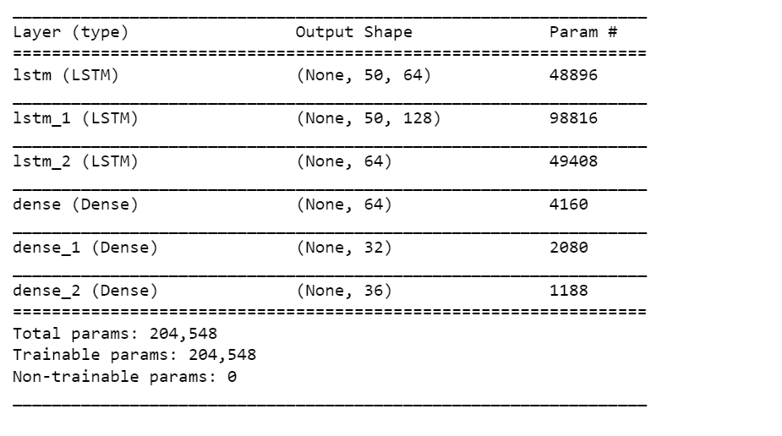
MODEL
Mediapipe helps us Collect the values of the Keypoints from each frames in the video.It will read the image that received in real-time, then on an image will do palm detection and make hand landmark that made return 3D hand key points and joint it make up like skeleton.
To identify the poses of the hand differently could be calculated using 42 key points on hand landmarks This identifying could be done with, firstly, determine it will determine the different position of the landmark of that particular sign , and then make the prediction which matches the maximum.

Slide 12
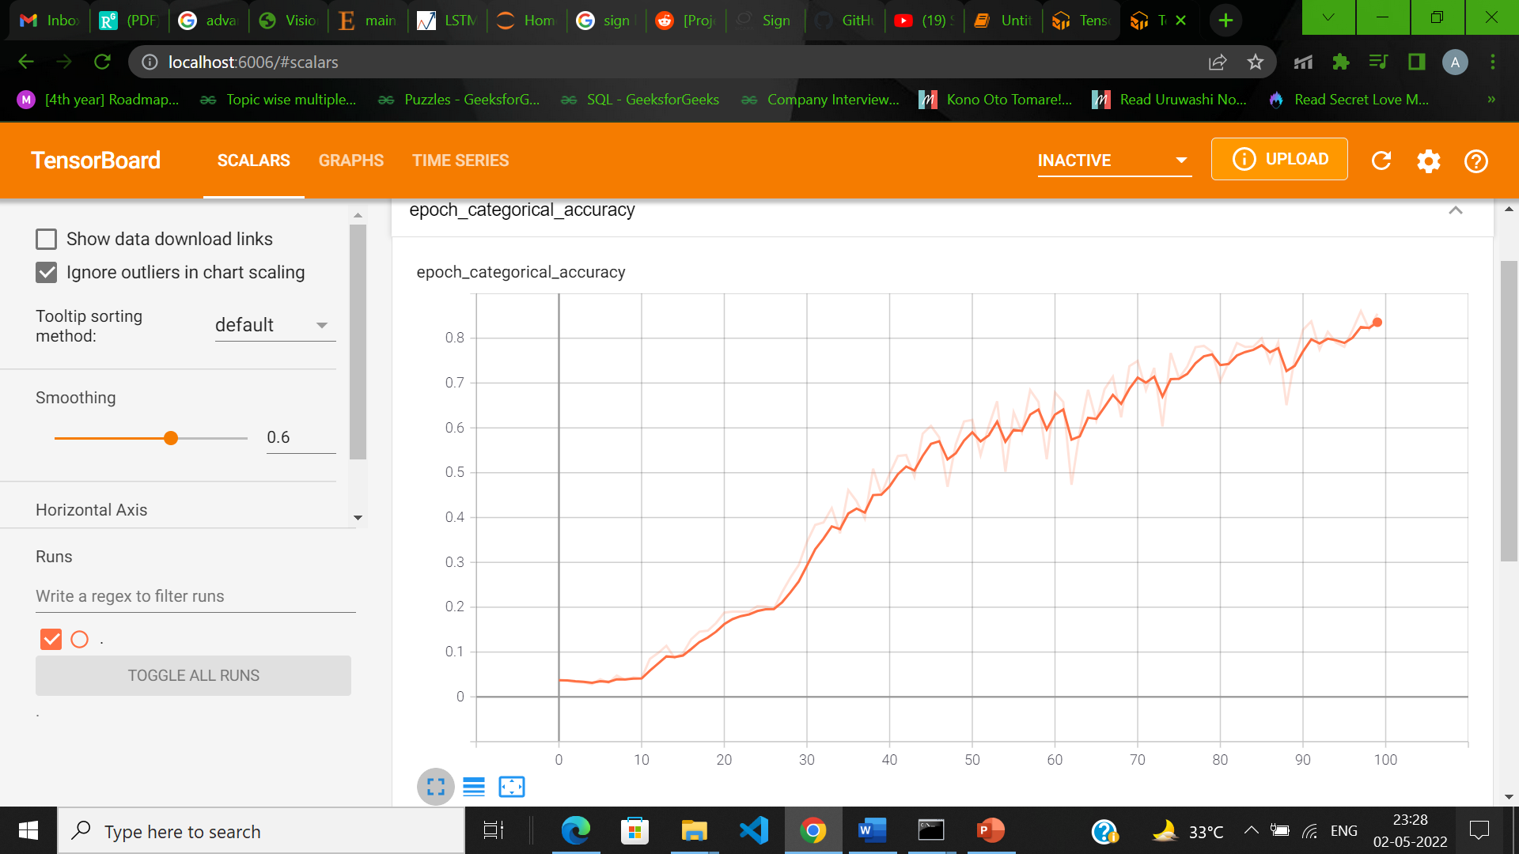
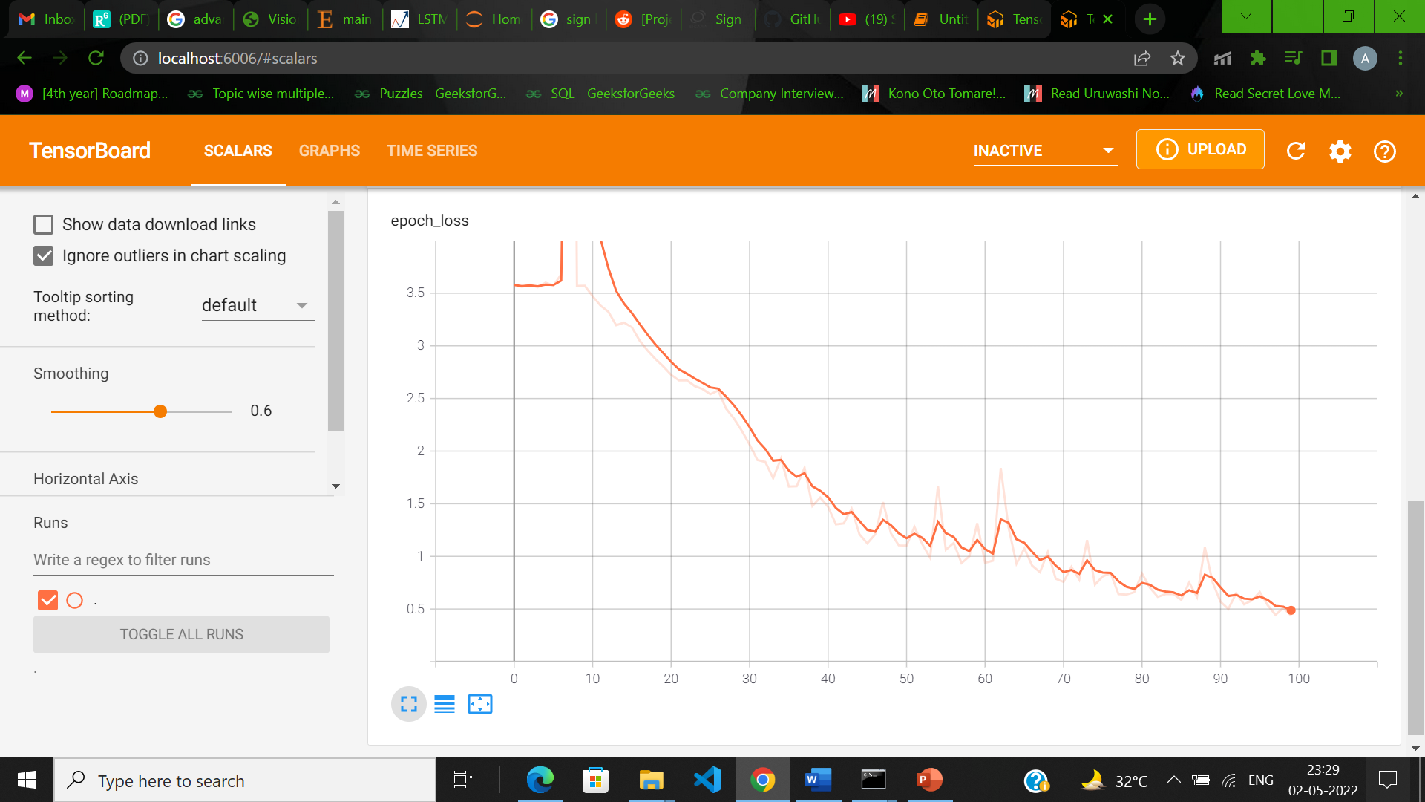
Fig: Epoce categogical accuracy
Fig: Epoce loss

Slide 13
Conclusion
Since we are using MediaPipe Our method doesn’t need to build a dataset with thousands of examples per class. However, we still need a few dozens of videos per sign to obtain good results.
The Background does not effect the model to detect the hands and estimate the results in real time.

Slide 14
REFERNCE
“Demand for Sign Language Interpreters Expected to Rise Nearly 50%”, A Sharp, http://wqad.com/2015/10/21/demand-for-sign-language-interpreters-expected-to-rise-nearly-50/, accessed 5/17/18
Z. Ren, J. Yuan, J. Meng and Z. Zhang, "Robust part-based hand gesture recognition using kinect sensor," IEEE Trans. Multimedia, vol. 15, no. 5, pp. 1110–1120, August 2013.
Padmavathi . S , Saipreethy.M.S, Valliammai.V, “Indian Sign Language Character Recognition using Neural Networks”, International Journal of Computer Applications, Special Issue on “Recent Trends in Pattern Recognition and Image Analysis", pp: 40- 45, RTPRIA 2013,
N.Priyadharsini, N.Rajeswari ,“Sign Language Recognition Using Convolutional Neural Networks ”, International Journal on Recent and Innovation Trends in Computing and Communication ISSN: 2321-8169 Volume: 5 Issue: 6, pp :625-628, June 2017
]M.A Hossen , Arun Govindaiah , Sadia Sultana , Alauddin Bhuiyan Bengali Sign Language Recognition Using Deep Convolutional Neural Network
O Al-Jarrah, Ali Mohammd Shatnawi, Alaa Halawani, “Recognition of gestures in Arabic Sign Language using neural networks”, Artificial Intelligence and Soft Computing, Spain, August 28-30, 2006.
B. C. Karmokar, K. M. R. Alam and M. K. Siddiquee, "Bangladeshi sign language recognition employing neural network ensemble," Int'l Journal of Computer Applications (IJCA), vol. 58, no. 16, pp. 43–46, November 2012.
M. A. Rahaman, M. Jasim, M. H. Ali and M. Hasanuzzaman, "Real-time computer vision-based Bengali sign language recognition," in 17th Int'l Conf. on Computer and Information Technology, Daffodil International University, Dhaka, Bangladesh, December 2014.
Md. Abdur Rahim, Tanzillah Wahid, Md. Khaled Ben Islam, “Visual Recognition of Bengali Sign Language using Artificial Neural Network”, International Journal of Computer Applications, Volume 94 - Number 17, pp : 1-5 , 2014

Slide 15
THANK YOU

